Slide 1

2024 Tennessee Legal Ethics Update
Professor Alex B. Long, University of Tennessee College of Law

Slide 2

Introduction
Program Format & Question Lineup

Slide 3
Today’s Program
Scenarios that Raise Attorney Ethics Issues
Tennessee Rules of Professional Conduct
Polling – Pick the Best Answer
Discussion

Slide 4

Today’s Lineup
Disqualification to Prevent the Misuse Use of “Confidential Government Information”
Disbarred!!! Rudy Giuliani and Dishonesty
Judicial Ethics
The Ethics of Witness Preparation
Confidentiality Obligations of Lawyers Posting to Listservs
Conflicts of Interest and Prospective Clients
Withdrawing from Representation
Zealous Advocacy or Just Being a Jerk? You Make the Call!

Slide 5

ABA Formal Opinion 509: Disqualification to Prevent the Misuse Use of “Confidential Government Information”

Slide 6
The General Conflict of Interest Rule for a Lawyer who has Formerly Served as a Public Officer or Employee of the Government

Slide 7

The General Conflict of Interest Rule for a Lawyer who has Formerly Served as a Public Officer or Employee of the Government
A county public defender wishes to hire the former district attorney of the same county as a full-time public defender. The public defender is authorized to have three full-time attorneys who defend criminal cases, as well as a full-time and a part-time attorney who handle matters in Family Court. The former district attorney would work solely in Family Court.
Question: Can the public defender’s office hire the former district attorney?
(NY State Bar Assn. Op. No. 1257)

Slide 8

The General Conflict of Interest Rule for a Lawyer who has Formerly Served as a Public Officer or Employee of the Government
Can the public defender’s office hire the former district attorney?
Yes
No

Slide 9

The General Conflict of Interest Rule for a Lawyer who has Formerly Served as a Public Officer or Employee of the Government: Rule 1.11(a)
(a): Except as law may otherwise expressly permit, a lawyer who has formerly served as a public officer or employee of the government:
…
(2) shall not otherwise represent a client in connection with a matter in which the lawyer participated personally and substantially as a public officer or employee, unless the appropriate government agency gives its informed consent, confirmed in writing, to the representation.

Slide 10
The General Conflict of Interest Rule for a Lawyer who has Formerly Served as a Public Officer or Employee of the Government
The public defender’s office hires the former district attorney. The PD’s office gets a case that the former district attorney was once personally and substantially involved in.
Question: Is the public defender’s office disqualified in the matter?

Slide 11
The General Conflict of Interest Rule for a Lawyer who has Formerly Served as a Public Officer or Employee of the Government: Rule 1.11(b)
(b): When a lawyer is disqualified from representation under paragraph (a), no lawyer in a firm with which that lawyer is associated may knowingly undertake or continue representation in such a matter unless both the personally disqualified lawyer and the lawyers who are representing the client in the matter act reasonably to:
(1) ascertain that the personally disqualified lawyer is prohibited from participating in the representation of the current client; and
(2) determine that no lawyer representing the client has acquired any material confidential government information relating to the matter; and
(3) promptly implement screening procedures to effectively prevent the flow of information about the matter between the personally disqualified lawyer and other lawyers in the firm; and
(4) advise the government agency in writing of the circumstances that warranted the utilization of the screening procedures required by this Rule and the actions that have been taken to comply with this Rule.

Slide 12
Confidentiality Obligations of Former and Current Government Officers and Employees
Lawyer formerly worked a local govt. entity. In that position, Lawyer supervised 10 other lawyers. Lawyer has since left this job and gone to work for Private Firm. Private Firm represents a client in a legal action against the same local govt. entity for whom Lawyer formerly worked. The matter was ongoing while Lawyer was employed, but Lawyer was not personally involved in the matter.
Question: Does Lawyer have a disqualifying conflict of interest that results in the disqualification of Private Firm?

Slide 13
The General Conflict of Interest Rule for a Lawyer who has Formerly Served as a Public Officer or Employee of the Government: Rule 1.11(a)
(a): Except as law may otherwise expressly permit, a lawyer who has formerly served as a public officer or employee of the government:
…
(2) shall not otherwise represent a client in connection with a matter in which the lawyer participated personally and substantially as a public officer or employee, unless the appropriate government agency gives its informed consent, confirmed in writing, to the representation.

Slide 14
The Special Conflicts of Interest Rules for Former and Current Government Officers and Employees

Slide 15

ABA Op. 509 (2024): Special Conflicts of Interest for Former and Current Government Officers and Employees
Rule 1.11(c)

Slide 16
Special Conflicts of Interest for Former and Current Government Officers and Employees
(c) Except as law may otherwise expressly permit, a lawyer having information that the lawyer knows is confidential government information about a person acquired when the lawyer was a public officer or employee may not represent a private client whose interests are adverse to that person in a matter in which the information could be used to the material disadvantage of that person. …

Slide 17
Special Conflicts of Interest for Former and Current Government Officers and Employees
(c) … As used in this Rule, the term "confidential government information" means information that has been obtained under governmental authority and which, at the time this Rule is applied, the government is prohibited by law from disclosing to the public or has a legal privilege not to disclose and which is not otherwise available to the public. A firm with which that lawyer is associated may undertake or continue representation in the matter only if both the personally disqualified lawyer and the lawyers who are representing the client in the matter comply with [screening procedures]

Slide 18
What confidentiality obligations does Rule 1.11(c) impose?

Slide 19
Confidentiality Obligations:
Comparison with Rule 1.6
Rule 1.6(a)
“Information relating to the representation of a client”
  Duty applies regardless of the source of info
  Not necessarily “confidential”

Slide 20
Confidentiality Obligations:
Comparison with Rule 1.6
Rule 1.6(a)
Rule 1.11(c)
“Information relating to the representation of a client”
  Duty applies regardless of the source of info
  Not necessarily “confidential”
“Confidential government information” acquired when the lawyer was a public officer or employee
  Obtained under governmental authority (e.g., search warrant)
  Govt. is prohibited by law from disclosing or is privileged

Slide 21
Confidentiality Obligations of Former and Current Government Officers and Employees
Lawyer served as an advisor to the Governor. In that capacity, she acquired “confidential government information” about a state entity.
Question: Is the information that Lawyer learned covered by Rule 1.11(c)?
Lawyer didn’t acquire info about an individual
Lawyer didn’t acquire info while acting in a representational capacity

Slide 22
ABA Op. 509 (2024): Special Conflicts of Interest for Former and Current Government Officers and Employees
“Rule 1.11(c) provides for disqualification ... to protect against the misuse of certain government information adversely to any “person” (i.e., an individual or an entity)”
“the rule applies irrespective of whether lawyers served in a representational capacity when they acquired the confidential government information.”

Slide 23
When does a disqualifying conflict of interest exist under Rule 1.11(c)?

Slide 24
Prohibited Conflict of Interest
Comparison with Rule 1.9
Rule 1.9(a)
Prohibits a lawyer from representing a new client against a former client in the same or substantially related matter in which the interests of that person are materially adverse
  “substantially related” – lawyer likely acquired confidential information that would materially advance the new client’s position

Slide 25
Prohibited Conflict of Interest
Comparison with Rule 1.9
Rule 1.9(a)
Rule 1.11(c)
Prohibits a lawyer from representing a new client against a former client in the same or substantially related matter in which the interests of that person are materially adverse
  “substantially related” – lawyer likely acquired confidential information that would materially advance the new client’s position
Prohibits a lawyer from representing a private client whose interests are adverse to a public officer or employee formerly represented by the lawyer where the lawyer acquired confidential government information that could be used to the material disadvantage of that person

Slide 26
Prohibited Conflict of Interest
Comparison with Rule 1.9
Rule 1.9(c)
“A lawyer who has formerly represented a client in a matter … shall not thereafter reveal information relating to the representation or use such information to the disadvantage of the former client unless ..

Slide 27
Prohibited Conflict of Interest
Comparison with Rule 1.9
Rule 1.9(c)
Rule 1.11(c)
“A lawyer who has formerly represented a client in a matter … shall not thereafter reveal information relating to the representation or use such information to the disadvantage of the former client unless ..
Prohibits a lawyer from representing a private clients whose interests are adverse to a public officer or employee formerly represented by the lawyer where the lawyer acquired confidential government information that could be used to the material disadvantage of that person

Slide 28
Confidentiality Obligations of Former and Current Government Officers and Employees
Lawyer served as an advisor to the Governor. In that capacity, she acquired confidential government information about a state entity. Lawyer now works at Private Firm, which represents a party suing the state entity. The information Lawyer acquired could be used to the material disadvantage of the state entity.
Question: Can the firm represent the party?

Slide 29
Confidentiality Obligations of Former and Current Government Officers and Employees
Can the firm represent the party?
Yes
No
Yes, if …

Slide 30
Special Conflicts of Interest for Former and Current Government Officers and Employees
(c) Except as law may otherwise expressly permit, a lawyer having information that the lawyer knows is confidential government information about a person acquired when the lawyer was a public officer or employee may not represent a private client whose interests are adverse to that person in a matter in which the information could be used to the material disadvantage of that person. …

Slide 31
Special Conflicts of Interest for Former and Current Government Officers and Employees
(c) … As used in this Rule, the term "confidential government information" means information that has been obtained under governmental authority and which, at the time this Rule is applied, the government is prohibited by law from disclosing to the public or has a legal privilege not to disclose and which is not otherwise available to the public. A firm with which that lawyer is associated may undertake or continue representation in the matter only if both the personally disqualified lawyer and the lawyers who are representing the client in the matter comply with [screening procedures]

Slide 32
Does Rule 1.11(c) apply exclusively to lawyers who are former public officers and employees?

Slide 33
Special Conflicts of Interest for Former and Current Government Officers and Employees
(c) Except as law may otherwise expressly permit, a lawyer having information that the lawyer knows is confidential government information about a person acquired when the lawyer was a public officer or employee may not represent a private client whose interests are adverse to that person in a matter in which the information could be used to the material disadvantage of that person. …

Slide 34
Confidentiality Obligations of Former and Current Government Officers and Employees
Lawyer is employed on a part-time basis as a lawyer for a local government. Lawyer also runs a private practice. In his capacity as a lawyer for the local government, lawyer acquires confidential government information about a person being sued by one of Lawyer’s clients. The information could be used to the material disadvantage of that person.
Question: Does Rule 1.11(c) prohibit Lawyer from representing this client?

Slide 35
Confidentiality Obligations of Former and Current Government Officers and Employees
Does Rule 1.11(c) prohibit Lawyer from representing this client?
Yes, the rule can apply to those who currently or formerly serve as govt. employees
No, because the rule only applies to former govt. employees

Slide 36
ABA Op. 509 (2024): Special Conflicts of Interest for Former and Current Government Officers and Employees
“the Committee reads the phrase “a lawyer having information that the lawyer knows is confidential government information about a person” to include not only lawyers formerly serving as public officers or employees but also lawyers who are currently serving as public officers or employees.”

Slide 37
Confidentiality Obligations of Former and Current Government Officers and Employees
Question: Does Rule 1.11(c) prohibit Lawyer from representing this client?

Slide 39

Disbarred!!! Rudy Giuliani and Dishonesty

Slide 40
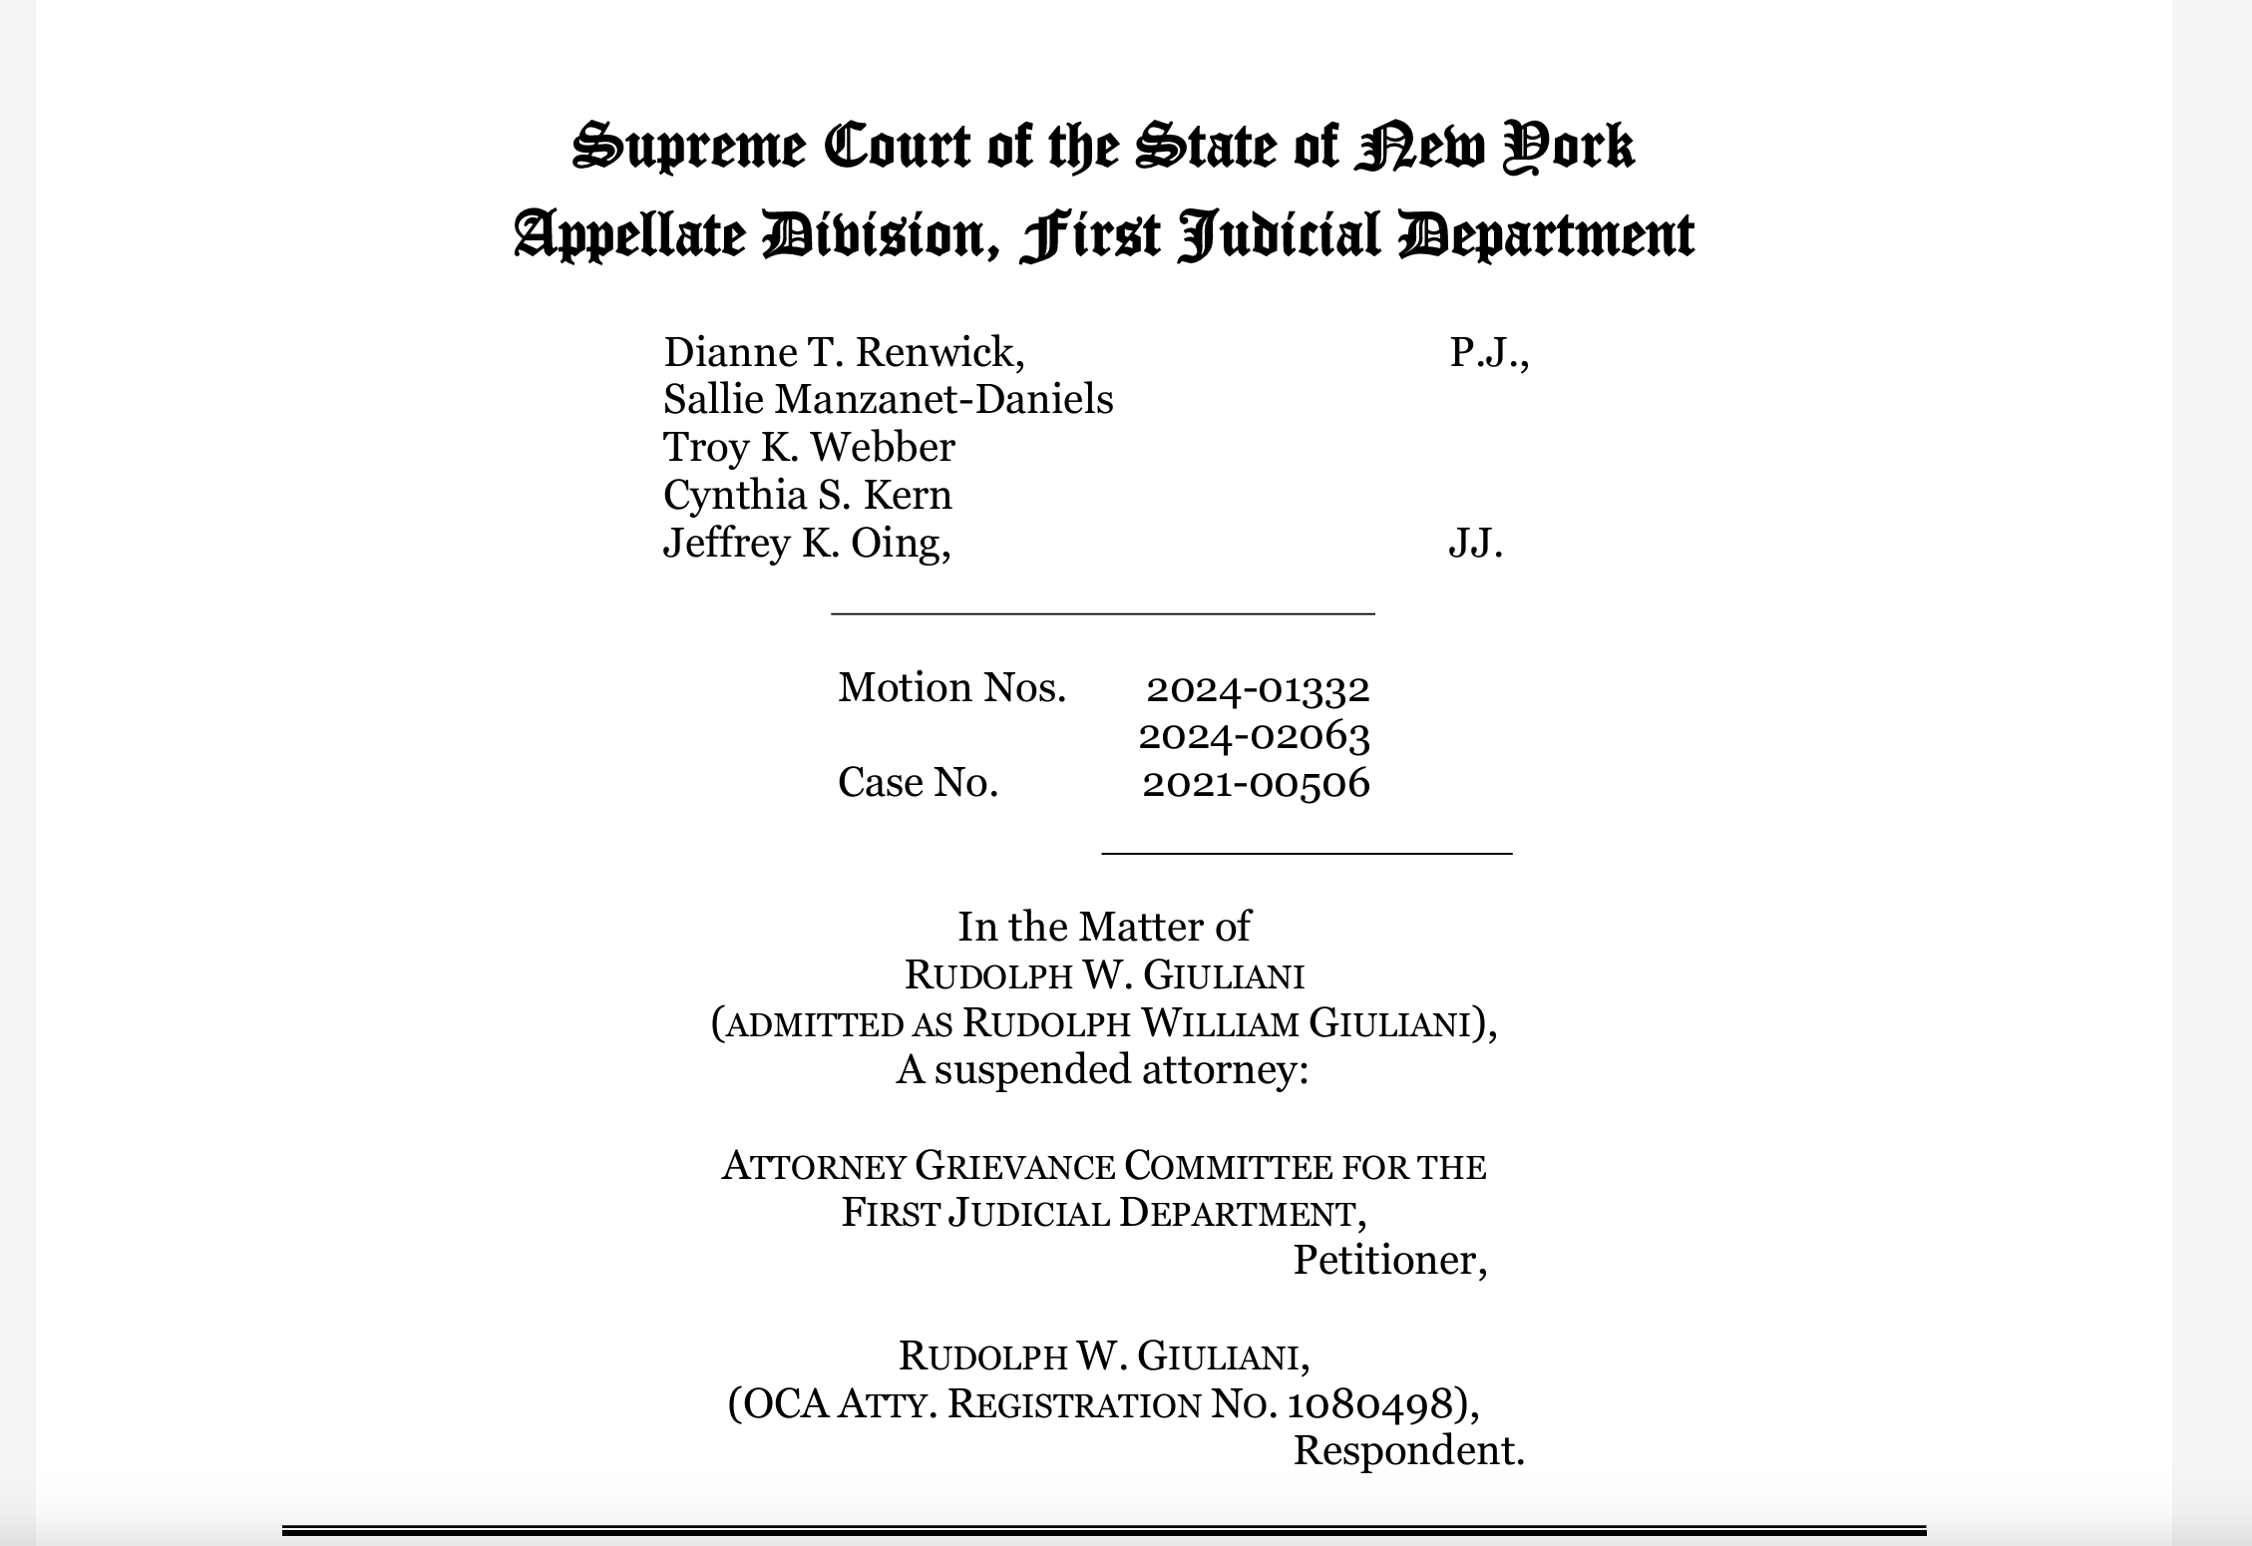

Slide 41
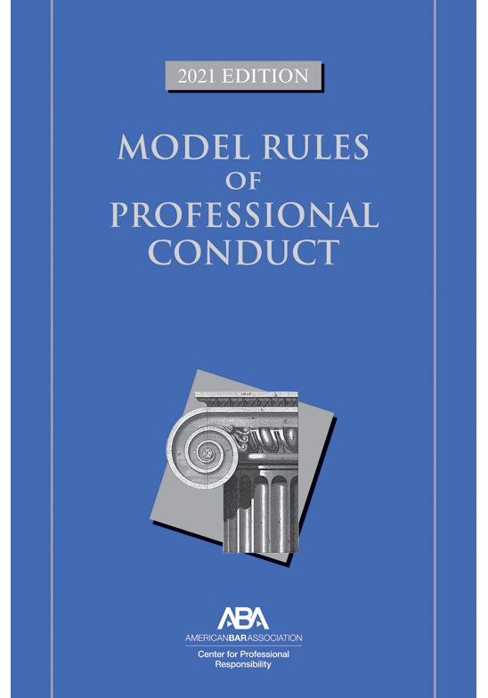
Misconduct in a Representative Capacity Occurring Outside a Judicial Proceeding
4.1(a): false statement of material fact to 3rd party
8.4(c): engaging in dishonest conduct
  dishonesty, fraud, deceit and misrepresentation
8.4(d): conduct prejudicial to the administration of justice

Slide 42

Some Examples …
“Tens of thousands” or “hundreds of thousands” of non-U.S. citizens voted in Arizona in 2020
“Many thousands” of dead people (including boxer Joe Frazier) voted in the 2020 election
“extraordinary number of voter fraud convictions” in Philadelphia over the years
  Actual total number between 2013 and 2022: 14
Outside of formal proceedings …

Slide 43
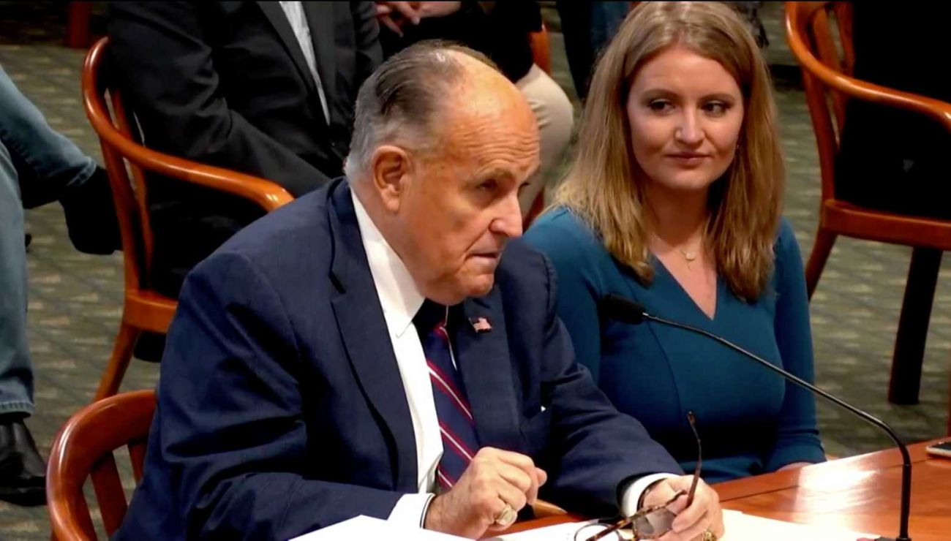
… and in legislative proceedings

Slide 44
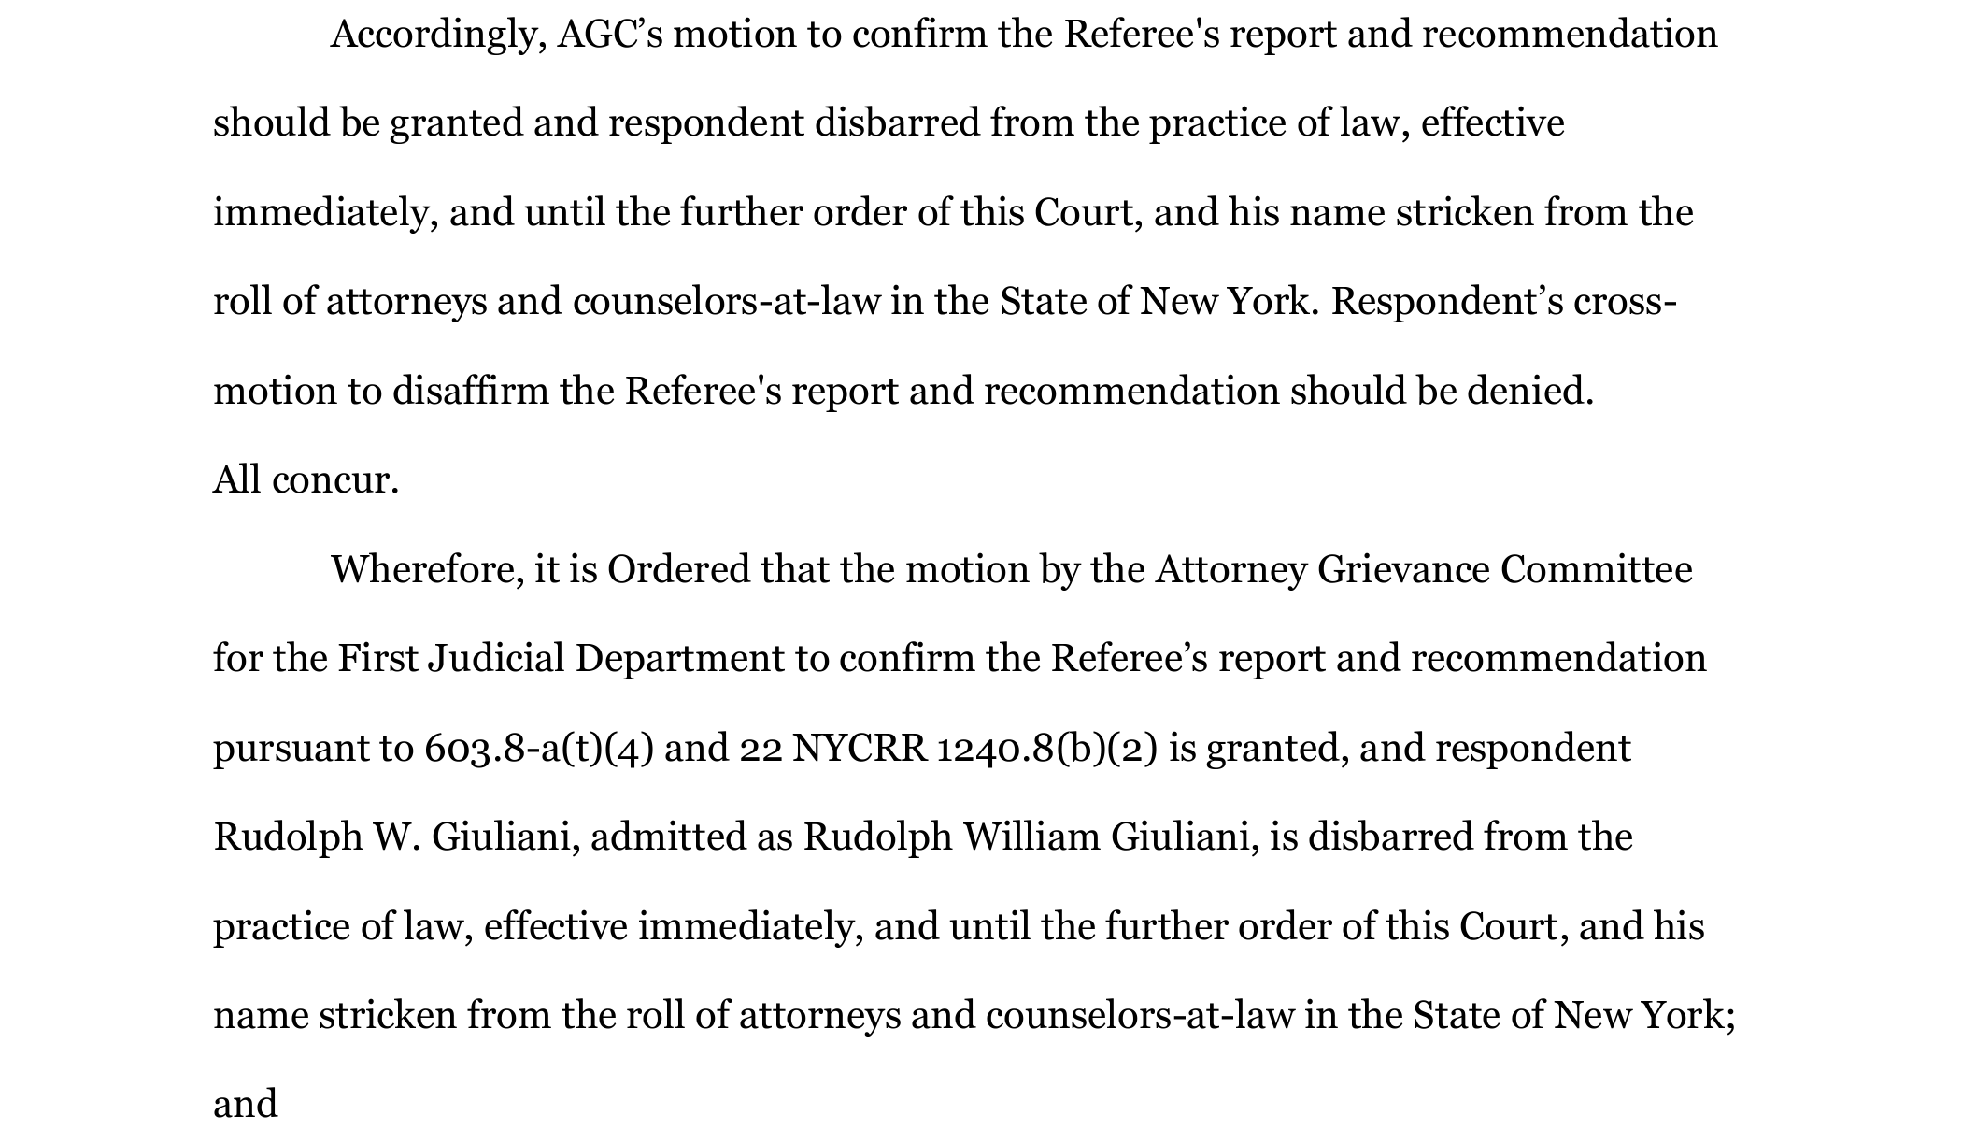

Slide 45
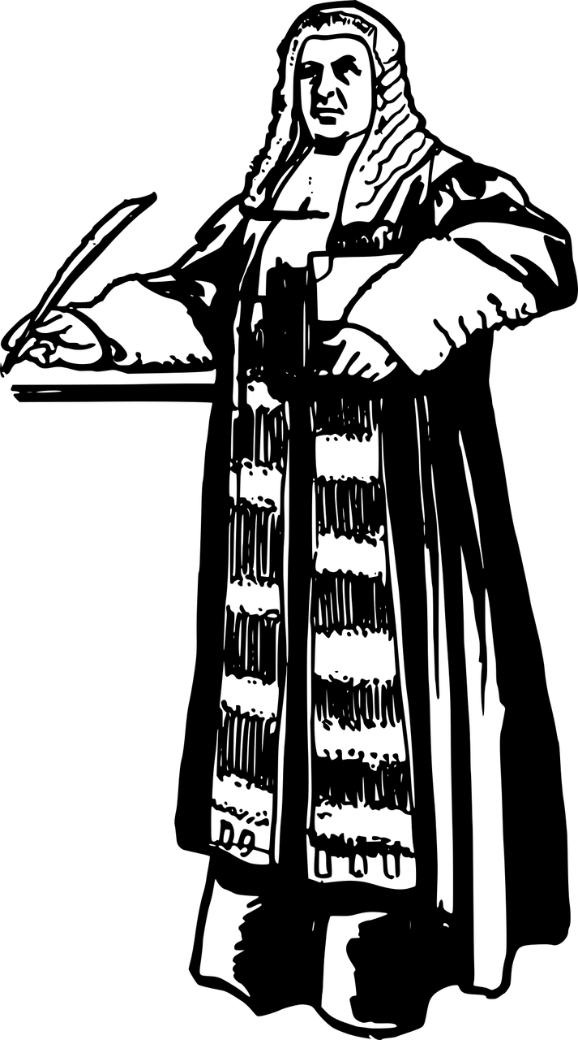
Judicial Ethics

Slide 46


Slide 47
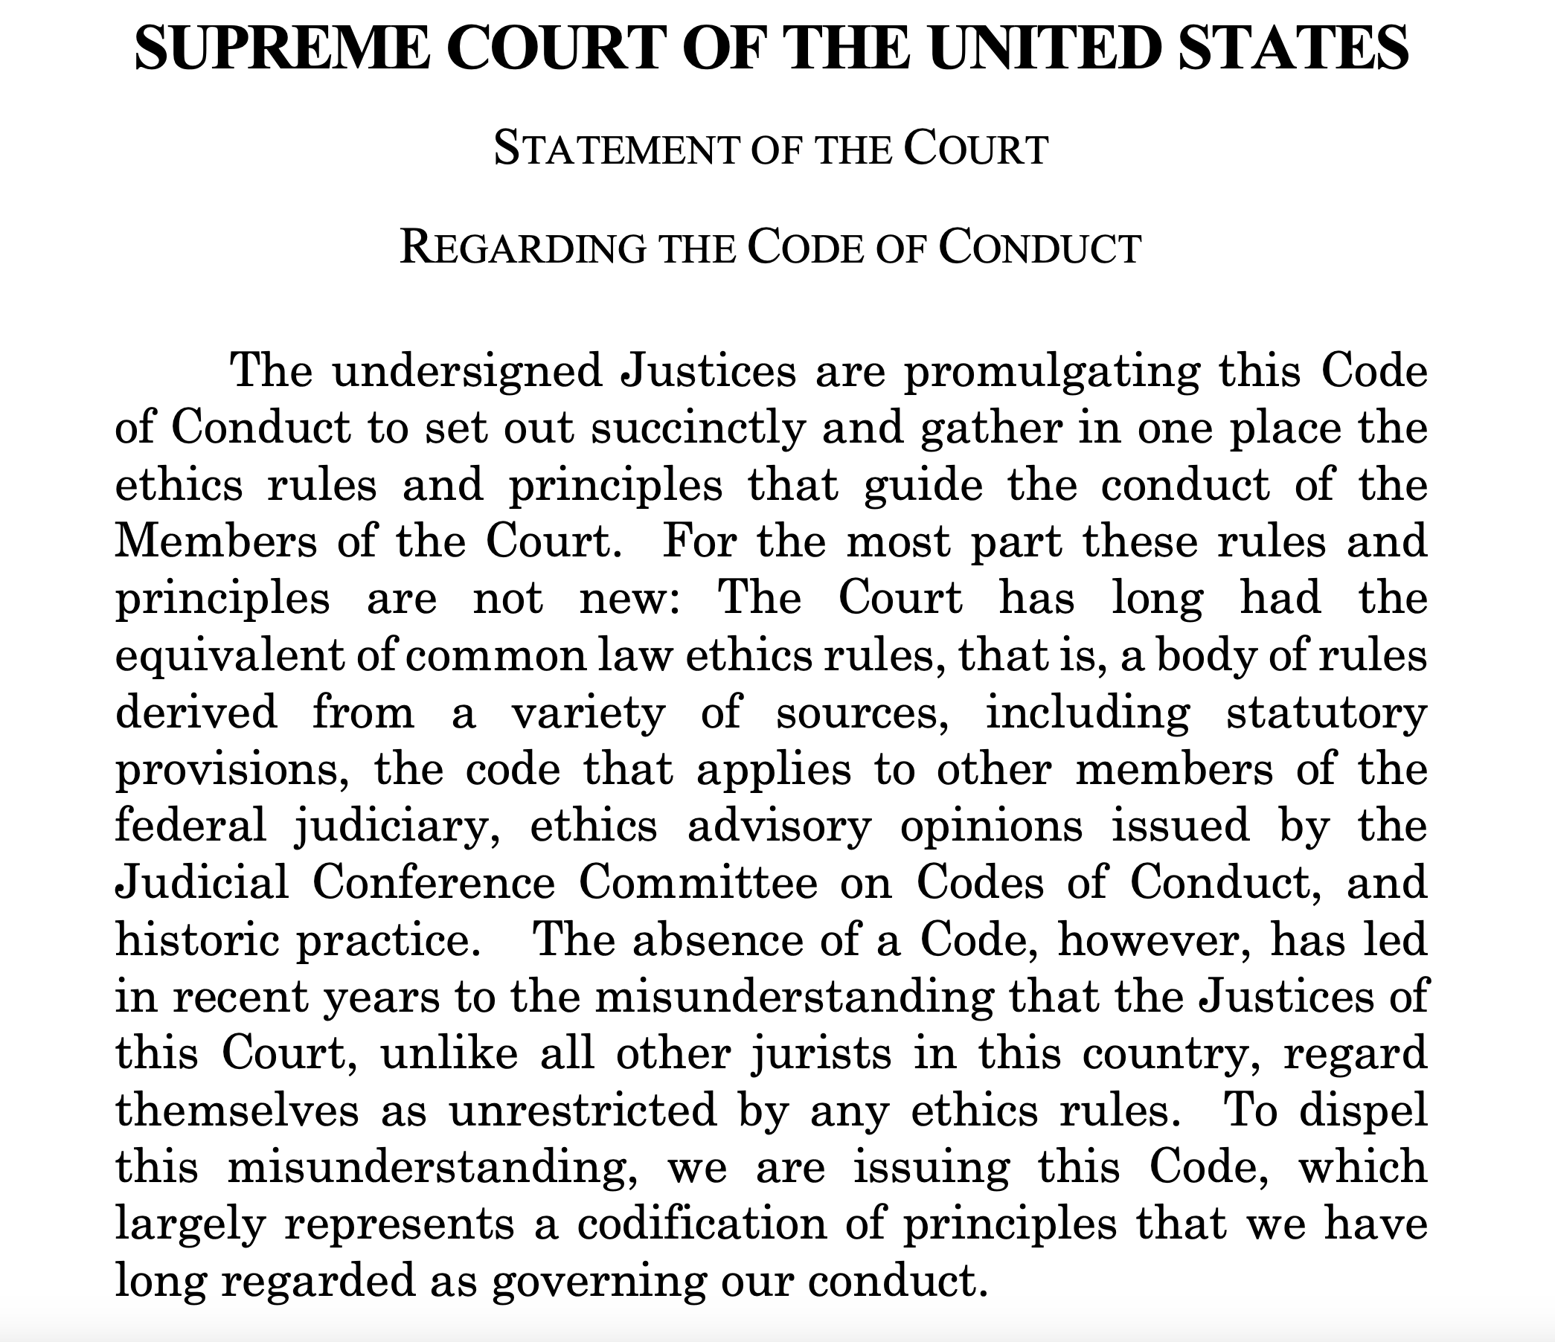

Slide 48

Receipt of Gifts by Supreme Court Justices
January 2004 – December 2023:
  Current Justices: 344 gifts/$3 million
  All Justices during this time: 546 gifts/$4.7 million
  Clarence Thomas: 103 gifts/$2.4 million
  Source: fixthecourt.com

Slide 49
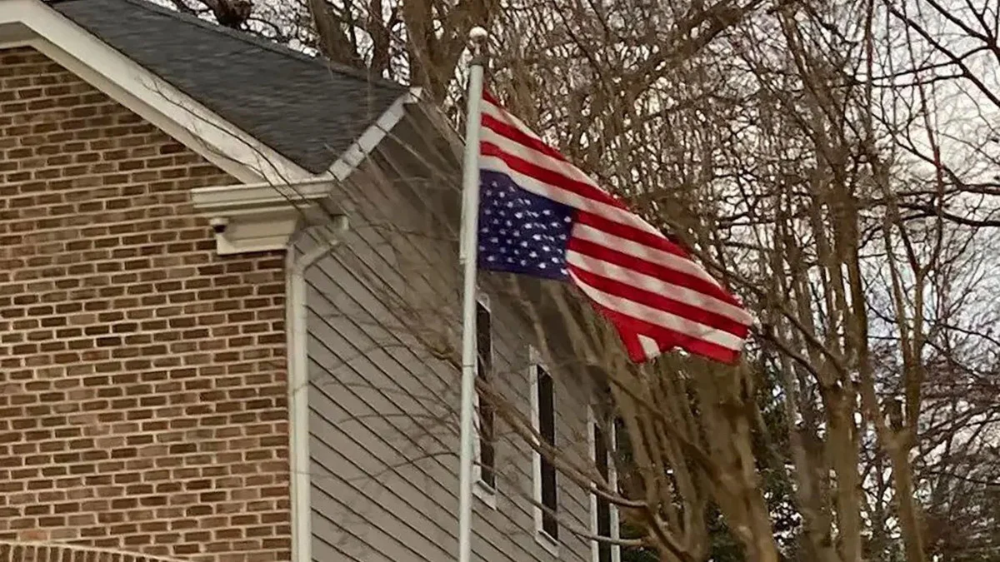



Slide 50
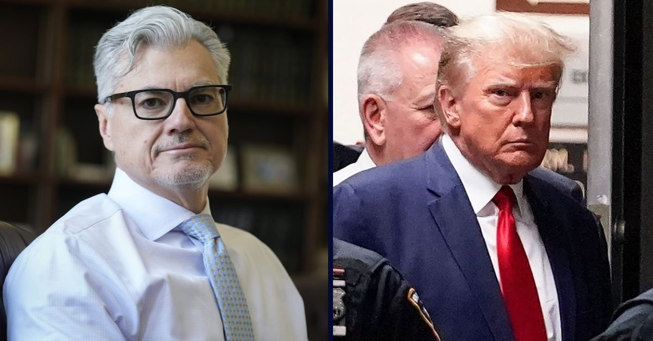

Slide 51
Judicial Ethics
Judge Alison is a trial court judge in Soddy Daisy. She puts a campaign sign on her front yard that supports a local candidate for political office, who happens to be the judge’s daughter. Is Judge Alison subject to discipline?

Slide 52
Is Judge Alison subject to discipline?
Yes, because judges are prohibited from engaging in political activity.
No, because the First Amendment protects her right to engage in political speech.
Yes, because judges are prohibited from endorsing another candidate for judicial office.
No, because a judge may publicly support the candidacy of a close relative.

Slide 53
Judicial Ethics
Judge Alison is a trial court judge in Soddy Daisy. She puts a campaign sign on her front yard that supports a local candidate for political office, who happens to be the judge’s daughter. Is Judge Alison subject to discipline?
Correct answer: (C). Yes, because judges are prohibited from endorsing another candidate for judicial office.
Rule 4.1(A)(3) prohibits a judge from publicly endorsing another candidate for judicial office. There is no exception for family members. Judges in other states have been disciplined under similar circumstances. See In re McGregor, 614 So. 2d 1089 (Florida 1993) (public reprimand).

Slide 54
Judicial Ethics
(2) Judge Alison is a trial court judge in Soddy Daisy. The judge’s spouse wants to put up a campaign sign endorsing a candidate for local office on the couple’s front yard. If Judge Alison’s spouse does so, is Judge Alison subject to discipline?

Slide 55
If Judge Alison’s spouse does so, is Judge Alison subject to discipline?
Yes, because judges are prohibited from engaging in political activity.
No, provided that the judge has first strongly encouraged her spouse to comply with the judge’s own ethical obligations that prohibit such endorsements.
Yes, because the judge has an ethical obligation to control the behavior of the judge’s spouse.
No, because a state may not constitutionally restrict a judge’s political speech.

Slide 56
Judicial Ethics
(2) Judge Alison is a trial court judge in Soddy Daisy. The judge’s spouse wants to put up a campaign sign endorsing a candidate for local office on the couple’s front yard. If Judge Alison’s spouse does so, is Judge Alison subject to discipline?
Correct answer: (B). No, provided that the judge has first strongly encouraged her spouse to comply with the judge’s own ethical obligations that prohibit such endorsements.
Rule 4.1(A)(3) prohibits a judge from publicly endorsing another candidate for judicial office. Ethics opinions are split on what, exactly, a judge’s ethical obligations are in such instances. But the majority take the position that the judge must “advise a spouse of the concerns that arise when a political sign is placed at their joint residence but acknowledge that, once the judge has ‘strongly urged’ that the sign not be placed on the property, [the judge] is not required to take further action if that attempt fails.” Cynthia Gray, Political Activity by Members of a Judge’s Family, American Judicature Society (1996). Regardless, Answer (B is clearly the best answer choice.

Slide 57
Judicial Ethics
(3) Judge Alison is a trial court judge in Soddy Daisy. She and her spouse both would like to make a financial contribution to the campaign of a local political candidate. Which of the following courses of action are ethically permissible?

Slide 58
Which of the following courses of action are ethically permissible?
The couple may make a contribution from their joint account.
Judge Alison can make a donation from her own personal account.
Judge Alison’s spouse can make a donation from the spouse’s personal account.
Neither spouse can make a donation.

Slide 59
Judicial Ethics
(3) Judge Alison is a trial court judge in Soddy Daisy. She and her spouse both would like to make a financial contribution to the campaign of a local political candidate. Which of the following courses of action are ethically permissible?
Correct answer: (C). Judge Alison’s spouse can make a donation from the spouse’s personal account.
Under Tennessee’s Code of Judicial Conduct, a judge is prohibited from making a donation to a political campaign. See Rule 4.1(A)(4). Most ethics opinions take the position that a judge’s spouse may donate money from the spouse’s separate account, at least provided that the judge’s name does not appear anywhere on the instrument. See, e.g., Colorado Advisory Opinion 06-4.

Slide 60
Judicial Ethics
(4) Judge Smith’s daughter is an associate at Law Firm. Law Firm is representing a client, Devon Moss, before Judge Smith. Judge Smith’s daughter is not involved in the case. The other party in the case is the bank with whom Judge Smith’s spouse keeps a separate checking account. The bank is suing Moss on a loan matter. Judge Smith briefly represented Moss several years ago in a personal injury case but has had no contact with him since that time. Which of the following statements is most accurate?

Slide 61
Which of the following statements is most accurate?
Judge Smith must disqualify herself because her impartiality might reasonably be questioned due to her daughter’s law firm’s involvement in the case.
Judge Smith must disqualify herself because her impartiality might reasonably be questioned due to his wife’s relationship with the bank.
Judge Smith must disqualify herself because her impartiality might reasonably be questioned due to her former representation of Moss.
None of the above.

Slide 62
Judicial Ethics
(4). Judge Smith’s daughter is an associate at Law Firm. Law Firm is representing a client, Devon Moss, before Judge Smith. Judge Smith’s daughter is not involved in the case. The other party in the case is the bank with whom Judge Smith’s spouse keeps a separate checking account. The bank is suing Moss on a loan matter. Judge Smith briefly represented Moss several years ago in a personal injury case but has had no contact with him since that time. Which of the following statements is most accurate?
Correct answer: (D). None of the above
A judge must disqualify himself or herself when the judge has a bias in favor of or against a party’s lawyer. But here, the judge’s daughter is not acting as a lawyer in the case, so A is wrong. Answer C is wrong because although party bias is grounds for disqualification, the judge’s relationship with Moss was professional and brief in nature. Thus, the judge’s impartiality could not reasonably be questioned. Disqualification is also required where the judge’s spouse has more than a de minimis interest that could be substantially affected by the proceeding. But it is hard to see how the interest of Judge Smith’s spouse could be impacted in any meaningful way by whether the bank wins or loses its suit. Thus, D is the best answer.

Slide 63
Judicial Ethics
(5) Judge Smith is forced to recuse herself in a matter because (a) she has a personal bias in favor of the defendant and (b) the judge knows that the plaintiff has made a financial contribution to the judge’s campaign such that the judge’s impartiality might reasonably be questioned. If the parties wish, can they agree to waive the judge’s disqualification?

Slide 64
If the parties wish, can they agree to waive the judge’s disqualification?
Yes, regarding the personal bias issue.
Yes, regarding the campaign contribution.
Yes, regarding both issues.
No, regarding either issue.

Slide 65
Judicial Ethics
(5) Judge Smith is forced to recuse herself in a matter because (a) she has a personal bias in favor of the defendant and (b) the judge knows that the plaintiff has made a financial contribution to the judge’s campaign such that the judge’s impartiality might reasonably be questioned. If the parties wish, can they agree to waive the judge’s disqualification?
Correct answer: (B). Yes, regarding the campaign contribution.
Rule 2.11(C) of the Tennessee Code of Judicial Conduct provides that “A judge subject to disqualification under this Rule, other than for bias or prejudice [concerning a party] may disclose on the record the basis of the judge’s disqualification.” Other grounds for disqualification may be waived if proper procedures are followed.

Slide 66
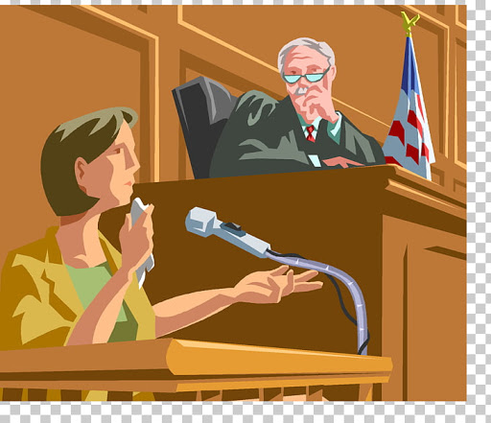
The Ethics of Witness Preparation

Slide 67
The Ethics of Witness Preparation
ABA Formal Opinion 508 (2023): The Ethics of Witness Preparation

Slide 68
The Ethics of Witness Preparation
Rule 1.1: Competence: A lawyer shall provide competent representation to a client. Competent representation requires the legal knowledge, skill, thoroughness, and preparation reasonably necessary for the representation.

Slide 69

The Ethics of Witness Preparation: What Preparatory Conduct is Ethical?
• reminding the witness that they will be under oath
• emphasizing the importance of telling the truth
• explaining that telling the truth can include a truthful answer of “I do not recall”
• explaining case strategy and procedure, including the nature of the testimonial process or the purpose of the deposition
• suggesting proper attire and appropriate demeanor and decorum

Slide 70
The Ethics of Witness Preparation: What Preparatory Conduct is Ethical?
• identifying lines of questioning and potential cross-examination
• suggesting choice of words that might be employed to make the witness’s meaning clear
• telling the witness not to answer a question until it has been completely asked
• telling the witness to testify only about what they know and remember and not to guess or speculate
• familiarizing the witness with the idea of focusing on answering the question, i.e., not volunteering information

Slide 71
The Ethics of Witness Preparation: Unethical Pre-Testimony Coaching
Rule 3.4: Fairness to Opposing Party and Counsel: A lawyer shall not
(b) falsify evidence, counsel or assist a witness to testify falsely, or offer an inducement to a witness that is prohibited by law
Rule 8:4: Misconduct: A lawyer shall not
(c) engage in conduct involving dishonesty, fraud, deceit or misrepresentation

Slide 72
The Ethics of Witness Preparation: Unethical Pre-Testimony Coaching?
Can a lawyer ethically advise a witness to “downplay” the number of times the witness met with the lawyer to prepare for trial in case the witness was asked about it on cross examination?
Yes
No

Slide 73
The Ethics of Witness Preparation: Unethical Pre-Testimony Coaching?
Can a lawyer ethically advise a witness to “downplay” the number of times the witness met with the lawyer to prepare for trial in case the witness was asked about it on cross examination?
Yes
No
In re Meltzer, 21 N.Y.S.3d 63, 64 (2015)

Slide 74

The Ethics of Witness Preparation: Unethical Pre-Testimony Coaching?
Client initially tells Lawyer that she fell on the sidewalk when exiting a church. Lawyer investigates the scene and realizes that the sidewalk outside of the church was not defective, but that the sidewalk across the street from the church was defective. Lawyer then explains to Client that if she fell when exiting the church, she would have no claim. But if she fell across the street, she would. Client then says that she fell across the street.

Slide 75
The Ethics of Witness Preparation: Unethical Pre-Testimony Coaching?
Do Lawyer’s actions amount to unethical coaching?
Yes
No

Slide 76
The Ethics of Witness Preparation: Unethical Pre-Testimony Coaching?
Do Lawyer’s actions amount to unethical coaching?
Yes
No
In re Rios, 965 N.Y.S.2d 418, 421, 423-24 (2013)

Slide 77
The Ethics of Witness Preparation: Unethical Conduct During Witness Testimony
Rule 8:4: Misconduct: A lawyer shall not
(d) engage in conduct prejudicial to the administration of justice
Examples:
winking at a witness during trial testimony,
kicking a deponent under the table
speaking objections

Slide 78

The Ethics of Witness Preparation: Unethical Conduct During Witness Testimony
Florida Bar v. James, 329 So.3d 108 (Fla. 2021)
Lawyer texts Client suggested answers while Client is being deposed
1:53 a.m. (James): Just say it anyway
11:53 a.m. (James): Just say 03/28
11:55 a.m. (James): Don't give an absolute answer
11:55 a.m. (James): It's a trap

Slide 79
The Ethics of Witness Preparation: Unethical Conduct During Witness Testimony
What level of professional discipline was imposed?
Disbarred
Suspended for more than 90 days
Suspended less than 90 days.
Public reprimand

Slide 80
The Ethics of Witness Preparation: Unethical Conduct During Witness Testimony
In re Claridge, PDJ 2021-9088 (Ariz. Jan. 21, 2022)
Lawyer provided answers to Client during a video deposition
Lawyer was off camera. Used chat feature of video conferencing system to provide answers.

Slide 81
The Ethics of Witness Preparation: Unethical Conduct During Witness Testimony
Barksdale School Portraits, LLC v. Williams, 339 F.R.D. 341 (D. Mass. 2021)
Lawyer whispers answers to Client during Zoom deposition

Slide 82

Which of the following is not an actual attorney ethics news item from 2024?
Colorado lawyer censured after calling other lawyer a “terrible f-----g lawyer” and “a disgrace to the Colorado Bar” in a demand letter.
Massachusetts lawyer publicly reprimanded after mistakenly emailing opposing counsel with plan to avoid judge’s phone call.
Tennessee lawyer suspended after punching Alabama football fan in a bar.
Wisconsin lawyer disbarred after threatening to sue client’s grandparents unless she waived attorney-client privilege so that lawyer could write a book about client’s case.

Slide 83

Confidentiality Obligations of Lawyers Posting to Listservs

Slide 84
Confidentiality Obligations of Lawyers Posting to Listservs
ABA Formal Opinion 511 (2024): Confidentiality Obligations of Lawyers Posting to Listservs

Slide 85
Confidentiality Obligations of Lawyers Posting to Listservs
Lawyer is a sole practitioner. She is a member of an e-mail listserv maintained by a professional organization in Tennessee that provides members the opportunity to exchange ideas and respond to questions about problems and issues that arise in their practices. Lawyer encounters an unusual situation in a case she is handling and wishes to receive advice on how to proceed from knowledgeable colleagues who participate in her listserv.
- Oregon Formal Op. No. 2011-184

Slide 86

The Duty of Confidentiality
TRPC Rule 1.6: Confidentiality of Information
(a) A lawyer shall not reveal information relating to the representation of a client unless:
(1) the client gives informed consent;
(2) the disclosure is impliedly authorized in order to carry out the representation; or
(3) the disclosure is permitted by paragraph (b) or required by paragraph (c).

Slide 87
ABA Formal Op. No. 98-411 (1998)
Is a lawyer impliedly authorized under Rule 1.6(a)(2) to disclose anonymized information relating to the representation of a client to another lawyer, outside the inquiring lawyer’s firm and without the client’s informed consent, to obtain advice about a matter when the lawyer reasonably believes the disclosure will further the representation?

Slide 88
ABA Formal Op. No. 98-411 (1998)
Is a lawyer impliedly authorized under Rule 1.6(a)(2) to disclose anonymized information relating to the representation of a client to another lawyer, outside the inquiring lawyer’s firm and without the client’s informed consent, to obtain advice about a matter when the lawyer reasonably believes the disclosure will further the representation?
Yes!

Slide 89
ABA Formal Op. 511(2024)
Is a lawyer is impliedly authorized under Rule 1.6(a)(2) to reveal similar information relating to the representation of a client to a wider group of lawyers by posting an inquiry or comment on a listserv?

Slide 90
ABA Formal Op. 511(2024)
Is a lawyer is impliedly authorized under Rule 1.6(a)(2) to reveal similar information relating to the representation of a client to a wider group of lawyers by posting an inquiry or comment on a listserv?
No!

Slide 91
ABA Formal Op. 511(2024)
“Participation in most lawyer listserv discussion groups is significantly different from seeking out an individual lawyer or personally selected group of lawyers practicing in other firms for a consultation about a matter.”
  Lawyers don’t necessarily know each other
  It’s possible the opposing lawyer is on the same listserv
  Harder to prevent the information from being disclosed to others

Slide 92
Confidentiality Obligations of Lawyers Posting to Listservs
Lawyer posts the following question on the listserv: “Does anyone know of useful case law on whether a warrantless search of a garbage bin outside a residence violates the Fourth Amendment?”
Question: Has Lawyer violated his duty of confidentiality under Rule 1.6?

Slide 93
Confidentiality Obligations of Lawyers Posting to Listservs
Lawyer posts the following question on the listserv: “Does anyone know of useful case law on whether a warrantless search of a garbage bin outside a residence violates the Fourth Amendment?”
Question: Has Lawyer violated his duty of confidentiality under Rule 1.6?
Answer: Probably not

Slide 94
Confidentiality Obligations of Lawyers Posting to Listservs
Lawyer posts the following question on the listserv: “Hypothetically, I’ve got a client in Soddy Daisy. The cops conducted a warrantless search of a garbage bin outside his residence. Does anyone know of any relevant caselaw?” There was recently a news story in the media about the arrest of an individual in Soddy Daisy based on a police search of a garbage bin.
Question: Has Lawyer violated his duty of confidentiality under Rule 1.6?

Slide 95
Has Lawyer violated his duty of confidentiality under Rule 1.6?
Yes, because lawyers can’t post client information on listservs.
No, because the information is not protected by the attorney-client privilege.
Yes, because there is a reasonable likelihood that the readers will be able to ascertain the identify of the client.
No, because the information is generally known by virtue of media reporting.

Slide 96
The Duty of Confidentiality: TRPC Rule 1.6: Confidentiality of Information, Comment 4:
Rule “applies to disclosures by a lawyer that do not in themselves reveal protected information but could reasonably lead to the discovery of such information by a third person.”

Slide 97
The Duty of Confidentiality: TRPC Rule 1.6: Confidentiality of Information, Comment 4:
“A disclosure of information in a way that cannot reasonably be linked to the client does not reveal information relating to the representation of a client in violation of this Rule.”
“a lawyer's use of hypotheticals to discuss issues relating to the representation is permissible so long as there is no reasonable likelihood that the listener will be able to ascertain the identity of the client or the situation involved.”

Slide 98
ABA Formal Op. 511(2024)
“if a matter is receiving media coverage or the group of listserv participants is comprised of a small, closely connected legal community, the risk of a Rule 1.6 violation is likely to be too great to permit the lawyer to post a hypothetical relating to the matter without the informed consent of the client.”

Slide 99
ABA Formal Op. 511(2024)
“The more unusual the situation, however, the greater the risk that the client can be identified, and therefore the greater the care that must be taken to avoid inadvertently disclosing client information protected by Rule 1.6.”

Slide 100
ABA Formal Op. 511(2024)
“when lawyers represent only one client (as in the case of in-house counsel or government lawyers) or their client’s identity can be readily inferred (as in the case of a litigator seeking assistance with a pending or contemplated action), “a description of specific facts or hypotheticals that are easily attributable to the client likely violates Rule 1.6 in most contexts.”

Slide 101

Conflicts of Interest and Prospective Clients

Slide 102
ABA Formal Op. 510 (2024)
Avoiding the Imputation of a Conflict of Interest When a Law Firm is Adverse to One of its Lawyer’s Prospective Clients

Slide 103

Goals of the Initial Client Interview?

Slide 104
Conflicts of Interest and Prospective Clients
Lawyer schedules an initial meeting with a potential client. After the individual describes, in broad strokes, the nature of her potential claim, Lawyer politely informs the individual that Lawyer does not wish to represent her.
Question: True or False: Lawyer owes this individual a duty of confidentiality.

Slide 105
True or False: Lawyer owes this individual a duty of confidentiality.
True
False

Slide 106
TRPC Rule 1.18: Duties to Prospective Client
(a) A person who consults with a lawyer about the possibility of forming a client-lawyer relationship with respect to a matter is a prospective client.
(b) Even when no client-lawyer relationship ensues, a lawyer who has learned information from a prospective client shall not use or reveal that information, except as RPC 1.9 would permit with respect to information of a former client.

Slide 107
TRPC Rule 1.18: Duties to Prospective Client
(a) A person who consults with a lawyer about the possibility of forming a client-lawyer relationship with respect to a matter is a prospective client.
(b) Even when no client-lawyer relationship ensues, a lawyer who has learned information from a prospective client shall not use or reveal that information, except as RPC 1.9 would permit with respect to information of a former client.

Slide 108
Conflicts of Interest and Prospective Clients
Lawyer schedules an initial meeting with a potential client. The individual provides substantial information concerning the nature of her potential claim. Lawyer politely informs the individual that Lawyer does not wish to represent her. A few weeks later, the opposing party in the same matter approaches Lawyer about the possibility of representing him.
Question: Can Lawyer represent this new individual?

Slide 109
Can Lawyer represent this new individual?
Yes, because Lawyer never entered into a lawyer-client relationship with the first individual
No, if Lawyer learned information from the first individual that could be significantly harmful to that individual in the same matter.

Slide 110
TRPC Rule 1.18: Duties to Prospective Client
(c) A lawyer subject to paragraph (b) shall not represent a client with interests materially adverse to those of a prospective client in the same or a substantially related matter if the lawyer received information from the prospective client that could be significantly harmful to that prospective client in the matter, except as provided in paragraph (d). …

Slide 111

If Lawyer is disqualified due to a conflict, is that conflict imputed to the other members of Lawyer’s firm?

Slide 112
TRPC Rule 1.18: Duties to Prospective Client
(c) … If a lawyer is disqualified from representation under this paragraph, no lawyer in a firm with which that lawyer is associated may knowingly undertake or continue representation in such a matter, except as provided in paragraph (d)/

Slide 113
TRPC Rule 1.18: Duties to Prospective Client
(d) When the lawyer has received disqualifying information as defined in paragraph (c), representation is permissible if:
(1) both the affected client and the prospective client have given informed consent, confirmed in writing, or:
(2) the lawyer who received the information took reasonable measures to avoid exposure to more disqualifying information than was reasonably necessary to determine whether to represent the prospective client; and
(i) the disqualified lawyer is timely screened from any participation in the matter; and
(ii) written notice is promptly given to the prospective client.

Slide 114
ABA Formal Op. 510 (2024)
What information is relevant for a lawyer to learn to determine whether to represent the prospective client?
What information is “reasonably necessary” for the lawyer to learn to make this determination?
What are the “reasonable measures” a lawyer should take “to avoid exposure” to disqualifying information?

Slide 115
ABA Formal Op. 510 (2024)
What information is relevant for a lawyer to learn to determine whether to represent the prospective client?
  Information related to the lawyer’s ethical responsibilities
    Conflict of interest?
  Information to help the lawyer decide whether the lawyer wants to take the case
    Information “to enable the lawyer to assess the amount of time the engagement will take, the range of anticipated compensation for that time, the potential expenses, and the likelihood of being fully compensated.”

Slide 116
ABA Formal Op. 510 (2024)
(2) What information is “reasonably necessary” for the lawyer to learn to make this determination?
useful/legitimate purpose vs. “reasonably necessary”
Useful but not necessary: “substantial investigation into the facts”
Reasonably necessary: “some inquiry into the facts” to determine whether the claim is frivolous or how likely the client is to prevail.

Slide 117
ABA Formal Op. 510 (2024)
(3) What are the “reasonable measures” a lawyer should take “to avoid exposure” to more information than is reasonably necessary?
Reasonable: warning the prospective client that the lawyer “has not yet agreed to take on the matter and that information should be limited only to what is necessary for the lawyer and client to determine whether to move forward with an engagement.”
Not reasonable: engaging in a “free-flowing conversation,” in which the lawyer allows the prospective client to take freely about the matter

Slide 118

Withdrawal from Representation

Slide 119
Withdrawal from Representation
Lawyer was appointed counsel for Mother in Mother’s termination of parental rights hearing.
Mother was not in the courtroom when trial began. The court asked Mother's counsel if she had any knowledge of her client's whereabouts.
Counsel responded by saying her assistant had texted her over an hour ago that Mother had just finished a job interview and gotten the job, but Counsel didn’t know where Mother was.

Slide 120
Withdrawal from Representation
Counsel orally moved to withdraw “[b]ased on the fact that [Mother] is not here, and also based upon the fact that she's had difficulties reaching my office and attending appointments with me.” Without further questioning, the court allowed Mother's counsel to withdraw.
Trial proceeded without Mother or her counsel.
Mother arrived during the testimony of the second witness and explained that she was late because of a job interview.
After the direct examination, the court informed Mother that her counsel had withdrawn.

Slide 121
Should the court have granted Counsel’s motion to withdraw?
Yes
No

Slide 122
TRPC Rule 1.16: Declining or Terminating Representation
“The principles embodied in the Rules of Professional Conduct should guide the court's decision on an attorney's motion to withdraw.”
  - In re Lila F., 2024 WL 1480174 (Tenn. Ct. App. April 5, 2024)

Slide 123
TRPC Rule 1.16: Declining or Terminating Representation
1.16(c): A lawyer must comply with applicable law requiring notice to or permission of a tribunal when terminating a representation. When ordered to do so by a tribunal, a lawyer shall continue representation notwithstanding good cause for terminating the representation.
An appointed attorney must seek leave of the court to withdraw. TENN. SUP. CT. R. 13 § 1(e)(5).

Slide 124
TRPC Rule 1.16: Declining or Terminating Representation
1.16(b): Permissive grounds for withdrawal:
  (1) withdrawal can be accomplished without material adverse effect on the interests of the client;
    [withdrawal occurred at trial]

Slide 125
TRPC Rule 1.16: Declining or Terminating Representation
1.16(b): Permissive grounds for withdrawal:
  (5) the client fails substantially to fulfill an obligation to the lawyer regarding the lawyer's services and has been given reasonable warning that the lawyer will withdraw unless the obligation is fulfilled;
  “We do not know how many appointments Mother missed or if Mother offered counsel any explanation for not attending. Nor did the court ascertain whether counsel gave Mother any prior warning that she intended to withdraw.” In re Lila F., 2024 WL 1480174 (Tenn. Ct. App. April 5, 2024)

Slide 126
TRPC Rule 1.16: Declining or Terminating Representation
1.16(b): Permissive grounds for withdrawal:
  (6) the representation will result in an unanticipated and substantial financial burden on the lawyer or has been rendered unreasonably difficult by the client;
  Mother had missed one meeting before, but …
  Counsel offered no other information about her efforts to communicate with her client during the representation.
  “Mother at least attempted to notify counsel about her whereabouts on the day of trial. Counsel did not indicate whether she tried to contact her client after receiving the email about the job interview.”

Slide 127
TRPC Rule 1.16: Declining or Terminating Representation
1.16(d): A lawyer who … withdraws from representation of a client, shall, to the extent reasonably practicable, take steps to protect the client's interests. Depending on the circumstances, protecting the client's interests may include:
(1) giving reasonable notice to the client;
(2) allowing time for the employment of other counsel; …

Slide 128
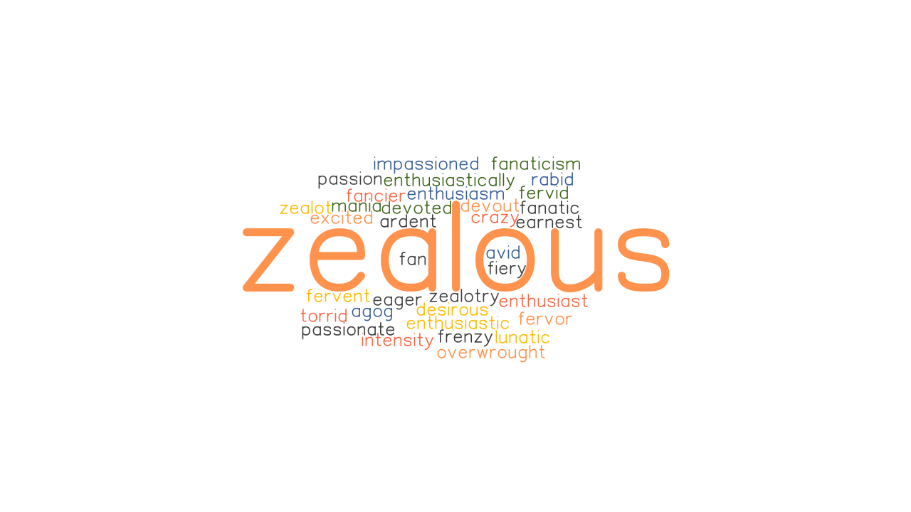
Zealous Advocacy or Just Being a Jerk? You Make the Call!

Slide 129
Zealous Advocacy or Just Being a Jerk?
Lawyer M represented Plaintiff in a health care matter.
The lawyer for one of the defendants died unexpectedly. His associated office notified Lawyer M that day.
At 12:48 p.m. that day, Lawyer M sent an email to the associate expressing his condolences and alerting her to several outstanding issues in several cases …

Slide 130
Zealous Advocacy or Just Being a Jerk?
… and then at 3:58 p.m. that same day, Lawyer M filed a Motion for Default Judgment in the health care case.
Question: Zealous advocacy or just being a jerk?

Slide 131
Zealous advocacy or just being a jerk?
Zealous advocacy
Just being a jerk

Slide 132
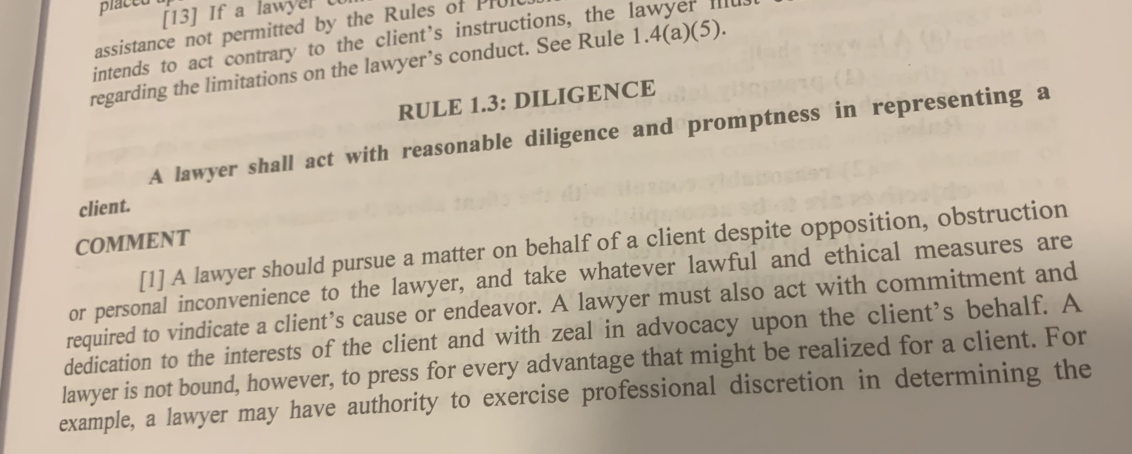
TRPC Rule 1.3: Diligence
Comment 4: “A lawyer must also act with commitment and dedication to the interests of the client and with zeal in advocacy upon the client's behalf. A lawyer is not bound, however, to press for every advantage that might be realized for a client. … The lawyer's duty to act with reasonable diligence does not require the use of offensive tactics or preclude the treating of all persons involved in the legal process with courtesy and respect.

Slide 133
Manookian v. Board of Professional Responsibility of Supreme Court of Tennessee, 685 S.W.3d 744 (Tenn. 2024)
“Being a zealous advocate does not mean that one abandons all sense of professionalism, courtesy and common decency. It is clear that counsel for plaintiff was attempting to gain a tactical advantage by aggressively pursuing the claim for default on the very day of Mr. Geracioti's death; despite the fact that all parties had been actively engaged in pretrial proceedings and plaintiff's counsel never complained after striking the original motion [for default judgment]....
It is with regret that this Court must reprimand all of plaintiff's counsel for conduct that is unbecoming members of the Bar and officers of the court. Hopefully counsel will apply this constructively and thereby avoid such reprehensible behavior in the future.”

Slide 134
Zealous Advocacy or Just Being a Jerk?
Lawyer G, the lawyer for one of the other defendants in the case, was Lawyer M’s former employer.
While in high school, Lawyer G’s daughter attended her high school after consuming alcohol. Was suspended from school.
Lawyer G sent Lawyer M an email detailing deficiencies in Lawyer M’s discovery responses.
Lawyer M responded with an email containing the following language:

Slide 135
Zealous Advocacy or Just Being a Jerk?
Lawyer G –
I hear [name of Lawyer G’s daughter] is working at [name of daughter's employer]. What a fantastic opportunity; particularly given her history of academic failure and alcohol and substance abuse.
I happen to have some very close friends at [name of daughter's employer]. I will make it a point to see what I can do regarding her prospects there. I am reminded that it is good for us to keep apprised of each other's lives and the things we can do to influence them.

Slide 136
Zealous advocacy or just being a jerk?
Zealous advocacy
Just being a jerk

Slide 137
Was he just being a jerk? Or did he actually violate a rule of professional conduct?
Just being a jerk
Violated a rule of professional conduct

Slide 138
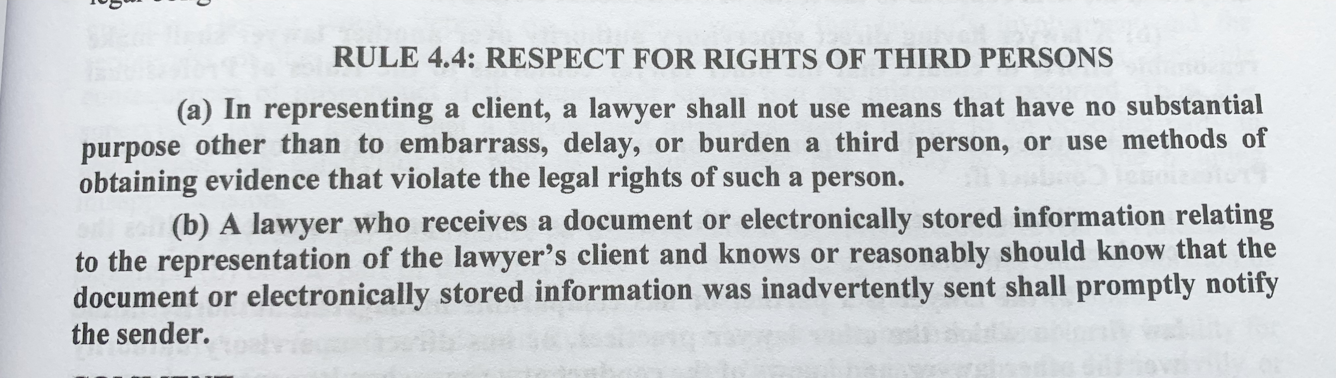
TRPC Rule 4.4: Respect for the Rights of Third Persons
(a) In representing a client, a lawyer shall not: (1) use means that have no substantial purpose other than to embarrass, delay, or burden a third person or knowingly use methods of obtaining evidence that violate the legal rights of such a person;

Slide 139
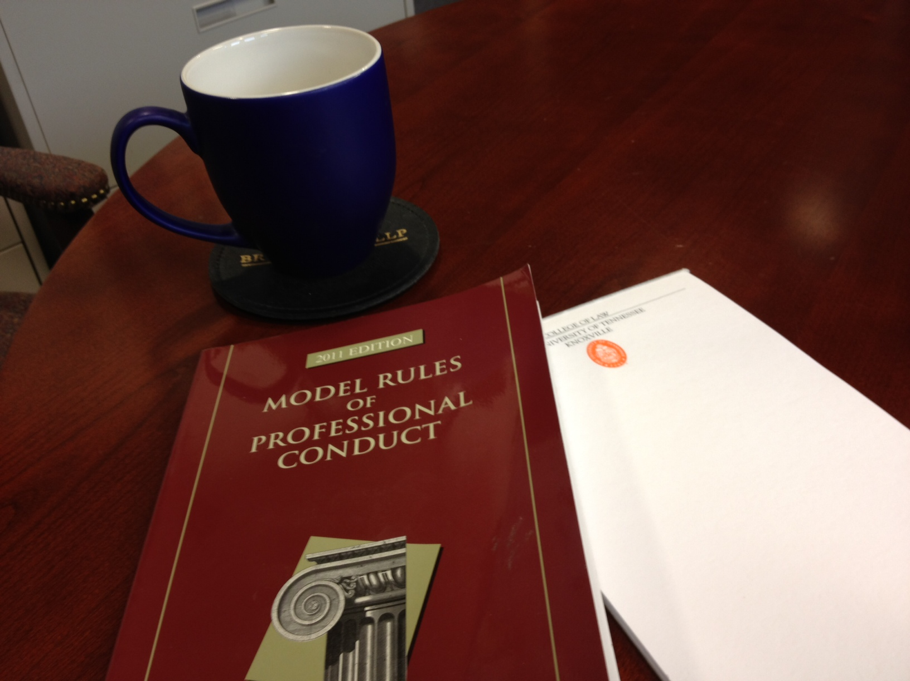
TRPC Rule 8.4 Misconduct
(d): Engaging in conduct prejudicial to the administration of justice

Slide 140
Manookian v. Board of Professional Responsibility of Supreme Court of Tennessee, 685 S.W.3d 744 (Tenn. 2024)
BPR Disciplinary Panel: “[T]he emails at issue served no substantial purpose other than to threaten, intimidate, demean, embarrass, harass and distract opposing counsel in the Shao case pending in the Circuit Court for Davidson County. None of the communications served to advance the litigation or advocate for Mr. Manookian's clients, which is the role of the trial lawyer.”

Slide 141
Zealous Advocacy or Just Being a Jerk?
Lawyer G filed a disciplinary complaint against Lawyer M. He included the email Lawyer M had sent but redacted his daughter’s name.
Lawyer M’s response included the email with the daughter’s name included.

Slide 142
Zealous Advocacy or Just Being a Jerk?
Lawyer M’s response also included a footnote referencing the fact that Lawyer M had previously represented Lawyer G’s son in an action against an individual seeking sexually explicit photographs of the son.

Slide 143
Zealous advocacy or just being a jerk?
Zealous advocacy
Just being a jerk

Slide 144
Was he just being a jerk? Or did he actually violate a rule of professional conduct?
Just being a jerk
Violated a rule of professional conduct

Slide 145
TRPC Rule 4.4: Respect for the Rights of Third Persons
(a) In representing a client, a lawyer shall not: (1) use means that have no substantial purpose other than to embarrass, delay, or burden a third person or knowingly use methods of obtaining evidence that violate the legal rights of such a person;

Slide 146
TRPC Rule 1.9 Misconduct
(c) A lawyer who has formerly represented a client in a matter or whose present or former firm has formerly represented a client in a matter shall not thereafter reveal information relating to the representation or use such information to the disadvantage of the former client unless (1) the former client gives informed consent, confirmed in writing, or (2) these Rules would permit or require the lawyer to do so with respect to a client, or (3) the information has become generally known.

Slide 147
TRPC Rule 8.4 Misconduct
(d): Engaging in conduct prejudicial to the administration of justice

Slide 148
Zealous Advocacy or Just Being a Jerk?
[Lots more bad behavior. See Manookian v. Board of Professional Responsibility of Supreme Court of Tennessee, 685 S.W.3d 744 (Tenn. 2024).]

Slide 149
Zealous Advocacy or Just Being a Jerk? You Make the Call!
What level of professional discipline was imposed?
Disbarred
Suspended for more than 90 days
Suspended less than 90 days.
Public reprimand

Slide 150
2024 Tennessee Legal Ethics Update
Professor Alex B. Long, University of Tennessee College of Law

