Slide 1
Presentation to:
Tennessee Municipal Attorneys Association Summer Seminar
August 4, 2025
Presented by: Matthew Lonergan
©Bradley Arant Boult Cummings LLP Attorney-Client Privileged.

Slide 2
Americans with Disabilities Act

Slide 3
ADA Basics
There can be no discrimination against employees OR applicants based on disability
Employers can be sued by someone who never worked for you
This applies to private employers, state and local governments (including schools)
There is a 15 employee threshold
NOTE: THRA – 8 employee threshold

Slide 4

Prohibited Actions
ADA states there can be no discrimination based on disability
For example: hiring, firing, discipline, training, etc.
No retaliation for exercising rights
Failure to make a reasonable accommodation
No illegal medical inquiries

Slide 5

Defining a Disability
ADA defines a disability as:
A physical or mental impairment that substantially limits one or more major life activities (MLAs)
An individual who has record of such impairment
A person regarded or seen as having such an impairment

Slide 6
Impairment that “substantially limits a major life activity”
Interpret “substantially limits” broadly
Does not have to be a “severe restriction” or “significant restriction” as compared to the average person BUT not transitory (< 6 months) AND minor (hangnails, common cold, etc.)
Consider chronic conditions if untreated or when they flare up
Does not have to affect person’s job performance
Pregnancy can be a disability

Slide 7

Things Not Covered by ADA
Current illegal drug use
Former addict, or current alcoholic, is covered
Sexual Behavior Disorders
Cross-dressing, Pedophilia, Voyeurism)
Compulsive gambling
Kleptomania or Pyromania

Slide 8

“Qualifications Must be Met”
Must be able to perform the “essential functions” of the job with or without reasonable accommodation
Pre-existing job description “may be” good evidence of essential functions
Can require no “direct threat of harm”
Medically determined

Slide 9
Reasonable Accommodation
Anything that enables an employee to perform a job’s essential functions
Reassignment to vacancy for which they are qualified
Modified facility or schedule
Leave
Talk to the employee– but doesn’t always get “first choice”
Removing an essential function of a position is not required
THRA does not impose an obligation of reasonable accommodation

Slide 10

Employee Requests a Reasonable Accommodation
Employee has to ask, but doesn’t have to mention ADA
No magic words:
“I need help doing the job because of my back problem”
“I have diabetes and need to take breaks to eat”
You can ask what their disability is, but don’t get hung up on whether you think that is a disability or if they need an accommodation

Slide 11

Interactive Process
Talk to employee about what they want
Let the employee tell you what they can or can’t do
Don’t make assumptions
Don’t assume the employee’s disability is the same as someone else’s
Get a doctor’s note and make sure you understand what the doctor is saying
Document this process carefully– it is a process, so it will likely require more than one step

Slide 12
The Deeper Dive on Reasonable Accommodation
The Interactive Process has become a substantial legal challenge
Could take numerous discussions and review
A simple “NO”, “We can’t do that” is rarely enough to meet the employer’s burden
Remembering the “past”
Is the job description “valid” and “current”

Slide 13

Timely Submissions and Unavailability for Work
IT Employee with Distributor
COVID – remote work and return to new office
Different leaves available
Rejecting remote work – performance issues
FMLA leave offered
Missed deadlines on submitting doctor’s statement for extension
3 attempts
Terminated on 3rd deadline missed
One day late – still out 6 weeks

Slide 14

Essential Functions
Production Tech
Auto manufacturing
Restrictions and sitting 50% of the time
Not perform all essential functions of the job sitting
Medical Leave for 12 months, then terminated
“Forgotten” accommodation issue with previous employee and similar restrictions
HR assessment – failed to include production and safety input

Slide 15
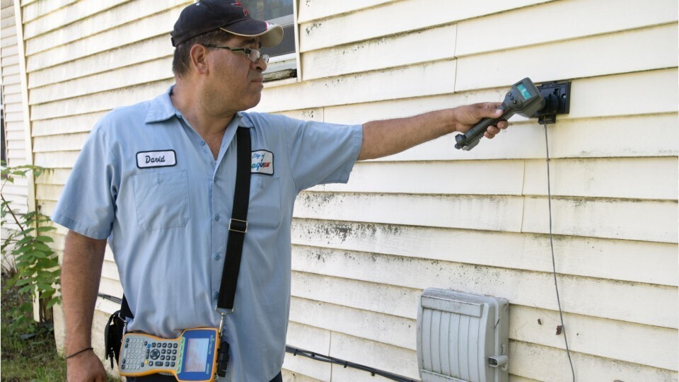
Physical Challenges
Water Meter Reader – City employee
Physical issues with extremities and outdoor work
Doctor’s statement took her out of her job
ADA form used – TN law applied
Employee “miscalculation”
Third party liability concerns
Employee resignation

Slide 16
Accommodation Complications
Prior Generous Accommodations
Accommodation not required by ADA, but employer does it anyway
Examples (extra leave, remote work, job duty reassignments)
Lack of coordination
HR not involved
Different practices at different locations or within different teams
Hard to argue something is an undue burden when done previously

Slide 17
Accommodation Complications
“reassignment to a vacant position” – 42 U.S.C. § 12111(9).
Prima facie showing of reasonableness:
Disabled and made limitations known to employer
Preferred accommodation cannot reasonably be accomplished within existing job
Employee identifies job, or requests employer identify through interactive process
Qualified to perform appropriate vacant job

Slide 18
Accommodation Complications
“reassignment to a vacant position” – 42 U.S.C. § 12111(9).
Limitations:
Employer does not have to alter existing policies, seniority rights, or CBA requirements
Must be a vacant position available
Individual may need to compete for the position (intent of ABA is equal opportunity). EEOC v. St. Joseph’s Hosp., Inc., 842 F.3d 1333 (11th Cir. 2016)

Slide 19
Accommodation Complications
Changing Job Duties
Do not need to alter/eliminate essential duties
Why past practice is so important – hard to say a duty is essential if waived
Turning temporary position into permanent one is not a reasonable accommodation. Daughtry v. Army Fleet Support, LLC, 925 F. Supp. 2d 1277, 1280 (M.D. Ala. 2013)

Slide 20

Questions?
Matt Lonergan
mlonergan@bradley.com
TN Rule 31 listed Civil Mediator
615.252.2322
Nashville, TN

